Slide 1

ICT 209 – SYSTEMS ANALYSIS & DESIGN
Lesson 1
Systems, Roles, and Development Methodologies
By
Samuel Agana

Slide 2

Learning Objectives
Understand the need for systems analysis and design in organizations.
Realize what the many roles of the systems analyst are.
Comprehend the fundamentals of three development methodologies:
SDLC
The agile approach
Object-oriented systems analysis and design

Slide 3
Major Topics
Fundamentals of different kinds of information systems
Roles of systems analysts
Phases in the systems development life cycle as they relate to Human-Computer Interaction (HCI) factors
CASE tools
Open Source Software

Slide 4
Information—A Key Resource
Fuels business and can be the critical factor in determining the success or failure of a business
Needs to be managed correctly
Managing computer-generated information differs from handling manually produced data

Slide 5
Information Systems
An information system is a combination of software, hardware, and telecom networks to collect useful data, especially in an organization.
Many businesses use information technology to complete and manage their operations, interact with their consumers, and stay ahead of their competition.
Some companies today are completely built on information technology, like eBay, Amazon, Alibaba, and Google.

Slide 6
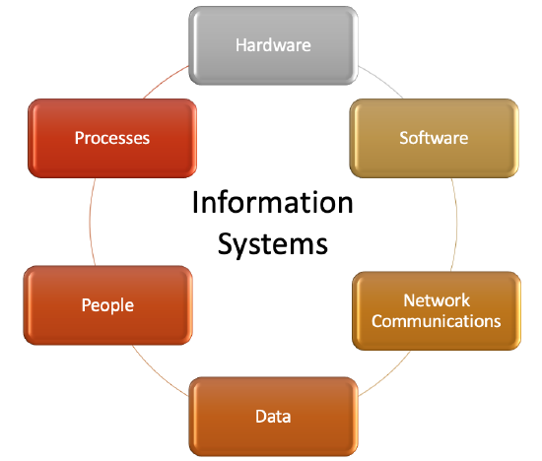
Information System Components

Slide 7
Need for Systems Analysis and Design
Installing a system without proper planning leads to great user dissatisfaction and frequently causes the system to fall into disuse
Lends structure to the analysis and design of information systems
A series of processes systematically undertaken to improve a business through the use of computerized information systems

Slide 8
Roles of the Systems Analyst
The analyst must be able to work with people of all descriptions and be experienced in working with computers
Three primary roles:
Consultant
Supporting expert
Agent of change

Slide 9
Qualities of the Systems Analyst
Problem solver
Communicator
Strong personal and professional ethics
Self-disciplined and self-motivated

Slide 10
Systems Development Life Cycle (SDLC)
The systems development life cycle is a phased approach to solving business problems
Developed through the use of a specific cycle of analyst and user activities
Each phase has unique user activities
SDLC has several models with their separate steps. The most popular ones are –
Waterfall Model
Iterative Model
Spiral Model
V-Model
Big Bang Model

Slide 11
The Seven Phases of the Systems Development Life Cycle

Slide 12
Incorporating Human-Computer Interaction (HCI) Considerations
The demand for analysts who are capable of incorporating HCI into the systems development process keeps increasing, as companies begin to realize that the quality of systems and the quality of work life can be improved by taking a human-centered approach at the outset of a project

Slide 13
Identifying Problems, Opportunities, and Objectives
Activity:
Interviewing user management
Summarizing the knowledge obtained
Estimating the scope of the project
Documenting the results
Output:
Feasibility report containing problem definition and objective summaries from which management can make a decision on whether to proceed with the proposed project

Slide 14
Determining Human Information Requirements
Activity:
Interviewing
Sampling and investing hard data
Questionnaires
Observe the decision maker’s behavior and environment
Prototyping
Learn the who, what, where, when, how, and why of the current system

Slide 15
Determining Human Information Requirements
Output:
The analyst understands how users accomplish their work when interacting with a computer
Begin to know how to make the new system more useful and usable
Know the business functions
Have complete information on the:
People
Goals
Data
Procedure involved

Slide 16
Analyzing System Needs
Activity:
Create data flow, activity, or sequence diagrams
Complete the data dictionary
Analyze the structured decisions made
Prepare and present the system proposal
Output:
Recommendation on what, if anything, should be done

Slide 17
Designing the Recommended System
Activity:
Design procedures for data entry
Design the human-computer interface
Design system controls
Design database and/or files
Design backup procedures
Output
Model of the actual system

Slide 18
Developing and Documenting Software
Activity:
System analyst works with programmers to develop any original software
Works with users to develop effective documentation
Programmers design, code, and remove syntactical errors from computer programs
Document software with help files, procedure manuals, and Web sites with Frequently Asked Questions
Output:
Computer programs
System documentation

Slide 19
Testing and Maintaining the System
Activity:
Test the information system
System maintenance
Maintenance documentation
Output:
Problems, if any
Updated programs
Documentation

Slide 20
Implementing and Evaluating the System
Activity:
Train users
Analyst plans smooth conversion from old system to new system
Review and evaluate system
Output:
Trained personnel
Installed system

Slide 21
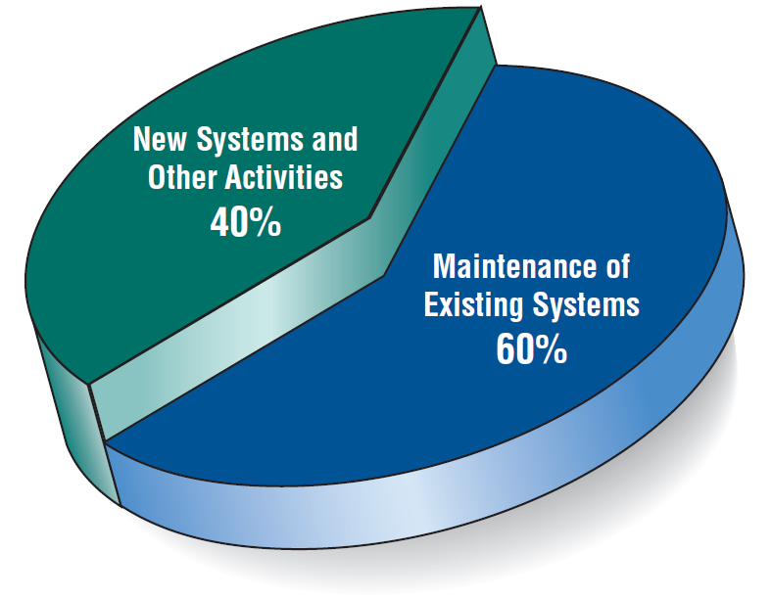
Some Researchers Estimate that the Amount of Time Spent on Systems Maintenance May Be as Much as 60 Percent of the Total Time Spent on Systems Projects (Figure 1.2)

Slide 22
The Impact of Maintenance
Maintenance is performed for two reasons:
Removing software errors
Enhancing existing software
Over time the cost of continued maintenance will be greater than that of creating an entirely new system. At that point it becomes more feasible to perform a new systems study.

Slide 23
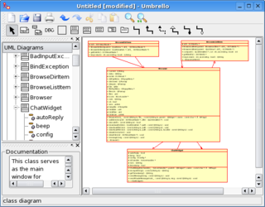
Case Tools
CASE tools are productivity tools for systems analysts that have been created explicitly to improve their routine work through the use of automated support

Slide 24
Case Tools
CASE tools support specific tasks in the software development life-cycle. They can be divided into the following categories
Business and Analysis modeling. Graphical modeling tools.
Development. Design and construction phases of the life-cycle. Debugging environments
Verification and validation. Analyze code and specifications for correctness, performance
Configuration management. Control the check-in and check-out of repository objects and files
Metrics and measurement. Analyze code for complexity, modularity
Project management. Manage project plans, task assignments, scheduling

Slide 25
Reasons for Using Case Tools
Reasons for using CASE tools
Increasing analyst productivity
Improving analyst-user communication
Integrating life cycle activities

Slide 26
Approaches to Structured Analysis and Design and to the Systems Development Life Cycle
Traditional systems development life cycle
Agile Approach to systems analysis and design
Object-oriented systems analysis and design

Slide 27
Agile Approach
Agile development approach is based on twelve broad principles which give a flexibility to implement the design of a system based on the changing requirements.
This approach does not follow a strict development life cycle and instead focuses on the actual working conditions where the development is taking place and who the customers are.
The system is capable of any new requirements arising or changing circumstances and can quickly adopt to it in an organization.

Slide 28
THE AGILE APPROACH
APPROACH | VALUES | RESOURCES
Values | Communication | Time
Principles | Simplicity | Cost
Core Practices | Feedback | Quality
 | Courage | Scope

Slide 29
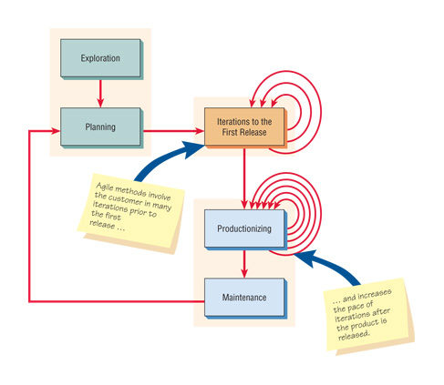
Five Stages of Agile Development
Exploration
Planning
Iterations to the first release
Productionizing
Maintenance

Slide 30
Object-Oriented (O-O) Systems Analysis and Design
Alternate approach to the structured approach of the SDLC that is intended to facilitate the development of systems that change rapidly in response to dynamic business environments
Analysis is performed on a small part of the system followed by design and implementation
The cycle repeats with analysis, design, and implementation of the next part and this repeats until the project is complete
Examines the objects of a system
Objects contain data and code (Data in the form of fields (attributes/properties) and code in the form of procedures/methods)

Slide 31
Unified Modeling Language (UML) Phases
UML is a general-purpose visual modeling language that is intended to provide a standard way to visualize the design of a system
Define the use case model:
Use case diagram
Use case scenarios
Create UML diagrams
Develop class diagrams
Draw statechart diagrams
Modify the UML diagrams
Develop and document the system

Slide 32
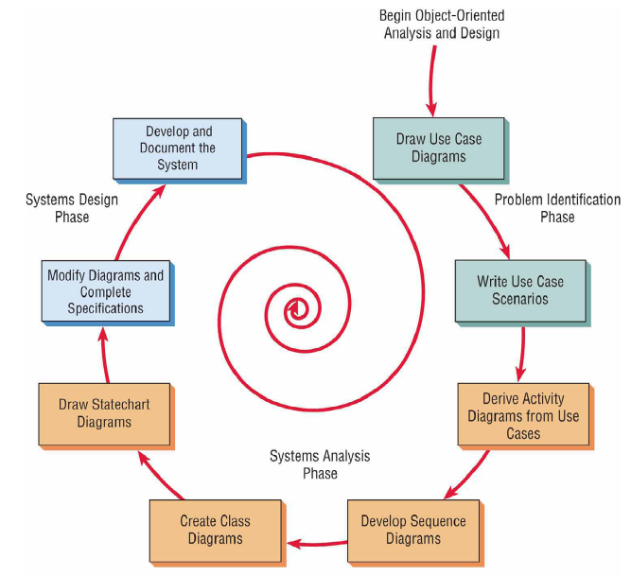

Slide 33
Choosing a Method
Choose either:
SDLC
Agile
Object-oriented methodologies

Slide 34
When to Use SDLC
Systems have been developed and documented using SDLC
It is important to document each step
Upper level management feels more comfortable or safe using SDLC
There are adequate resources and time to complete the full SDLC
Communication of how new systems work is important

Slide 35
When to Use Agile
When there is a project champion of agile methods in the organization
When the applications need to be developed quickly in response to a dynamic environment
When a rescue takes place (the system failed and there is no time to figure out what went wrong)
When the customer is satisfied with incremental improvements
When the executives and analysts agree with the principles of agile methodologies

Slide 36
When to Use Object-Oriented
The problems modeled lend themselves to classes
An organization supports the UML learning
Systems can be added gradually, one subsystem at a time
Reuse of previously written software is a possibility
It is acceptable to tackle the difficult problems first

Slide 37
Open Source Software
An alternative of traditional software development where proprietary code is hidden from the users
Open source software is free to distribute, share, and modify
Characterized as a philosophy rather than simply the process of creating new software
Examples: Linux Operating System, Apache Web Server, Mozilla Firefox

Slide 38
Four Types of Open Source Communities:
Ad hoc
Standardized
Organized
Commercial

Slide 39
Six Key Dimensions that Differentiate Open Source Communities
General structure
Environment
Goals
Methods
User community
Licensing

Slide 40
Reasons for Participating in Open Source Communities
Rapidity with which new software can be developed and tested
Faster to have a committed group of experts develop, test, and debug code
This fosters creativity
Have many good minds work with innovative applications
Potential to reduce development costs
Bolster their self-image
Contribute something worthwhile to the software development community

Slide 41
Open Source Contribution and Differentiation
Contributions to the open community and differentiation from the open community are for the following reasons:
Cost
Managing resources
Time it takes to bring a new product to the market

Slide 42
Reasons for Analyst Participation in the Open Source Community
Curiosity about software benefits
Achieve collective design
Incorporate open source software design into:
Proprietary products
Processes
Knowledge
IT artifacts

Slide 43
Collective Design
Through a process of collective design the IT artifact is imbued with
Community and organizational structures
Knowledge
Practices

Slide 44
Summary
Information is a key resource
Integration of traditional systems with new technologies
Roles and qualities of the systems analyst
The systems development life cycle
CASE tools
Agile systems development
Object-oriented systems development
Open source systems

